Slide 1
DND Live Image Generator
Digcre
Cyrill Tschopp / Alex Wyss

Slide 2
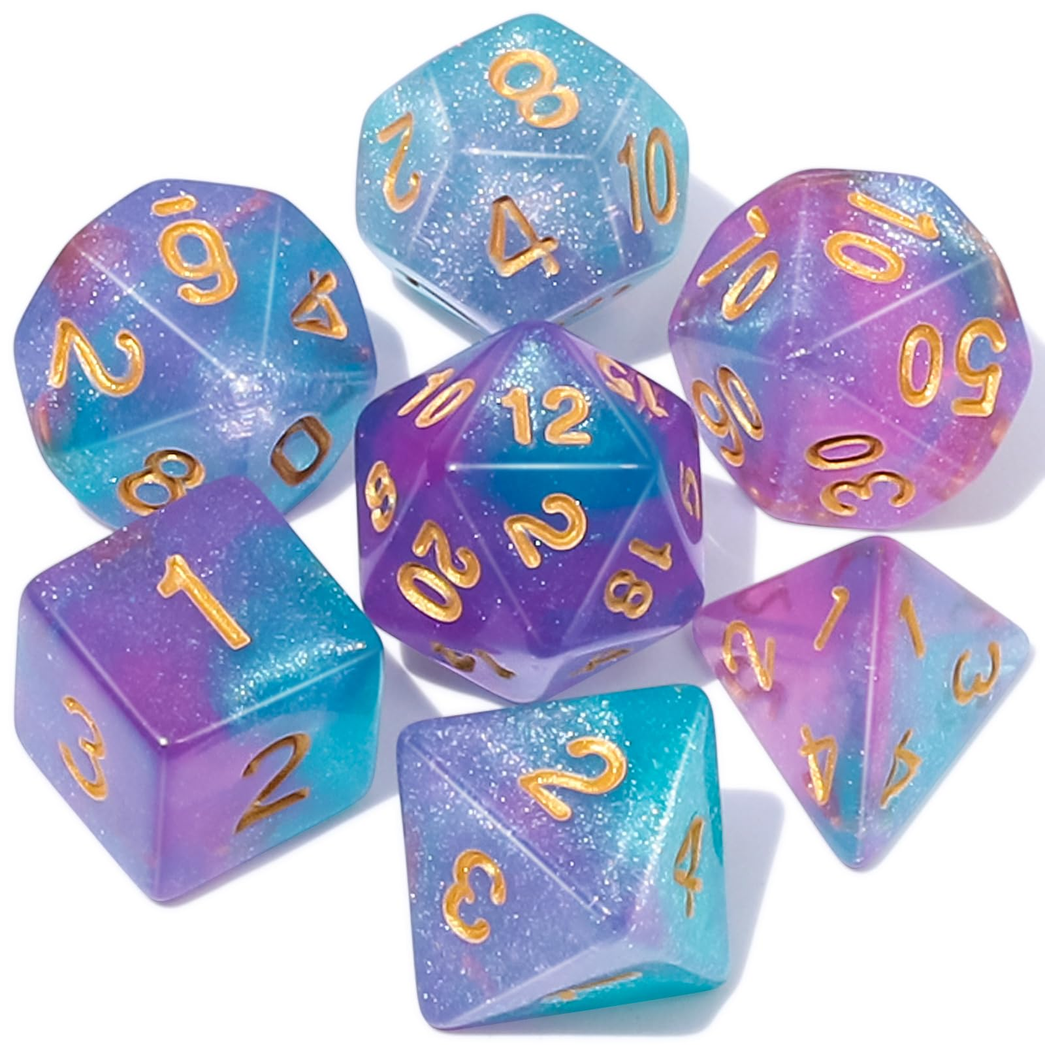
Base Idea
DND Session Recording
Speech to text
Promting using LLM
Image Generation using live Prompt
Displaying Image as soon as Available

Slide 3
Technologies
Python
Discord / Discord Bot
Replicate
Whisper
Llama ?
Picture Model?

